Slide 1
t=0
t=1
t=2
t=3
residual
Input frame sequence
ANN layers ex. Conv/pool
SNN layers ex. LIF2D
Hybrid layer ConvLIF2D

Slide 2
Frame sequences T=1 to Tmax
[T, C, H, W]
Time_distributed conv/pool
Layer 1
LIF
Layer 2
Layer 3
State dependency
Frame sequences
Conv/pool
State dependent layers, ex. LIF

Slide 3
t=1 to Tmax
t
State dependency
Frame sequences
Conv/pool
State dependent layers, ex. LIF

Slide 4


data
mapping matrix
act.
func.
data vector
$$×N$$
address
vector
storage matrix
output memory vector
clue
mapping matrix
act.
func.
normalization
storage matrix
storage matrix
$$×C$$

Slide 5
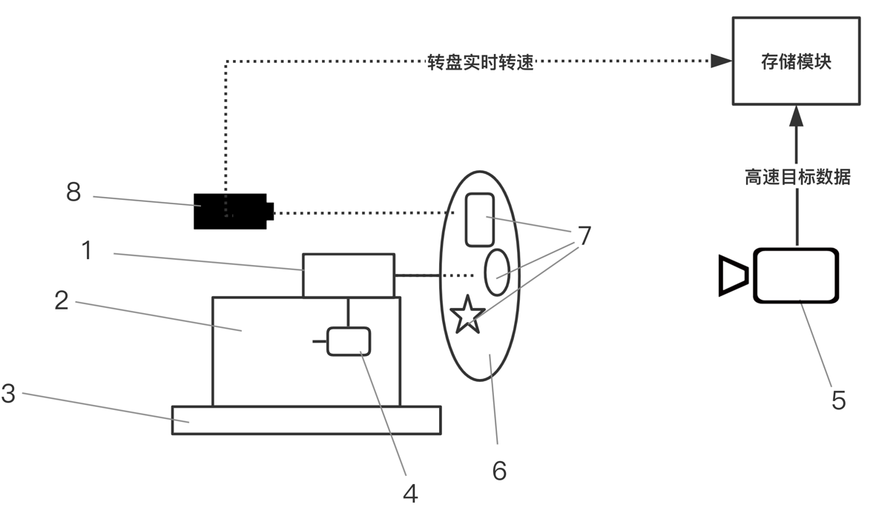
rotate speed
storage
block
High speed target data
Device | Name | Description
1 | Servo Motor | It is used to drive the turntable to rotate at high speed.
2 | Fixing Device | It is used to fix the position of the servo motor and prevent it from shaking violently during rotation.
3 | Shock Absorber | It works with the fixing device to reduce the severe vibration of the servo motor during operation.
4 | Governor | It is used to control the rotation speed of the servo motor shaft.
5 | DVS Camera | It is used to collect the target data when rotating at high speed.
6 | Turntable | It is driven to rotate by the servo motor and carries the patterns to be detected.
7 | Different Patterns | They can be different types of decals or monitors, representing the targets moving at high speed.
8 | Tachometer | It detects the rotation speed of the high-speed turntable in real time.

Slide 6
Conv
_{BBox calculate}
bbox
∑
*β
fire:T_{max}
not fire:T-20
Conv
L
T_{o}
T
I
inv
Conv
-
X
O
Lateral inhibition preprocessing
PCNN recursive for N times
post-processing

Slide 7
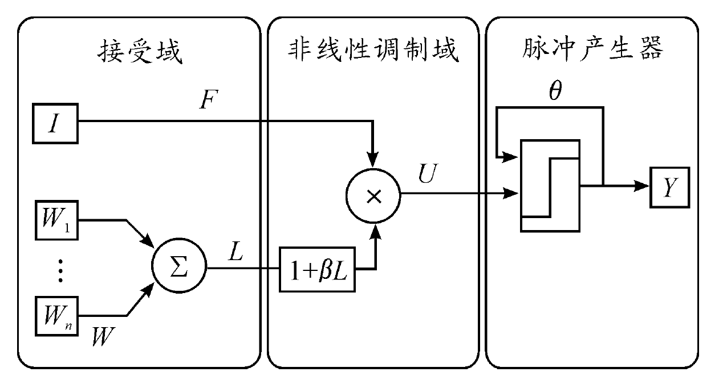
receptive field
non-linear modulation field
pulse generator

